Slide 1

INNOVATIVE PROJECT
Symbiosis Skills & Professional University, Pune
School of Computer Science & Information Technology
PROJECT TITLE: Restaurant Management System
Project Members:
Varun K. 2201106048
Atharva B. 2201106148
Karan P. 2201106151
Om S. 2201106153
Omkar S. 2201106166
Project Guide: Prof. Veer S. & Prof. Parul B.

Slide 2
Index
Project Title
Problem Statement
Introduction
Objectives
Methodology/Architechture
Working
Results/Outputs
Conclusion

Slide 3
Problem statement
Restaurants that handle both in-house orders and deliveries often struggle with maintaining efficiency and accuracy due to the lack of an integrated system.
Streamlined Restaurant Order and Delivery Management System with Automated Billing for Enhanced Efficiency for administrator use. The system will focus on:
1. Order Management
2. Delivery Coordination
3. Order Status Monitoring
4. Automated Billing

Slide 4
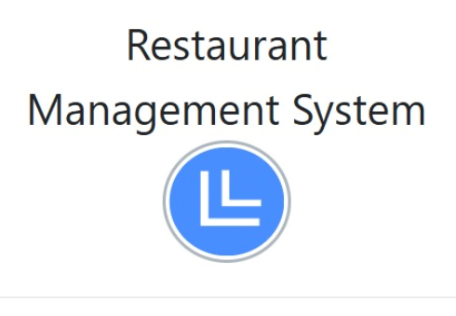
Introduction
In today's fast-paced restaurant industry, efficiency and accuracy are critical to ensuring customer satisfaction and smooth operations. Restaurants handling both in-house and delivery orders often face challenges such as order mix-ups, billing inefficiencies The project automates restaurant operations, providing an efficient way to manage orders, tables, menu updates, and payments through a centralized system.

Slide 5
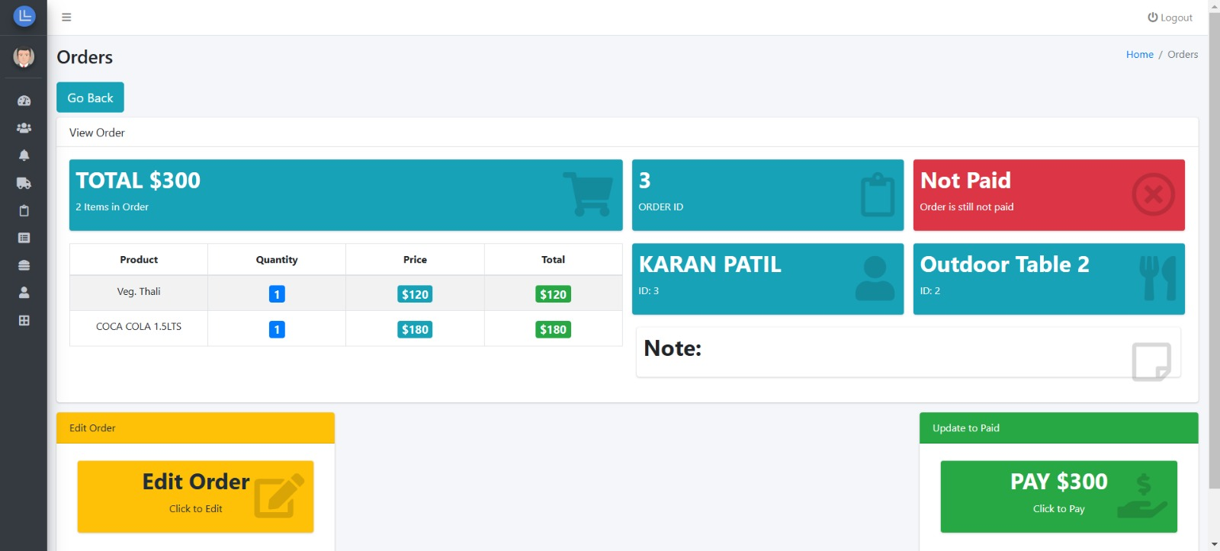
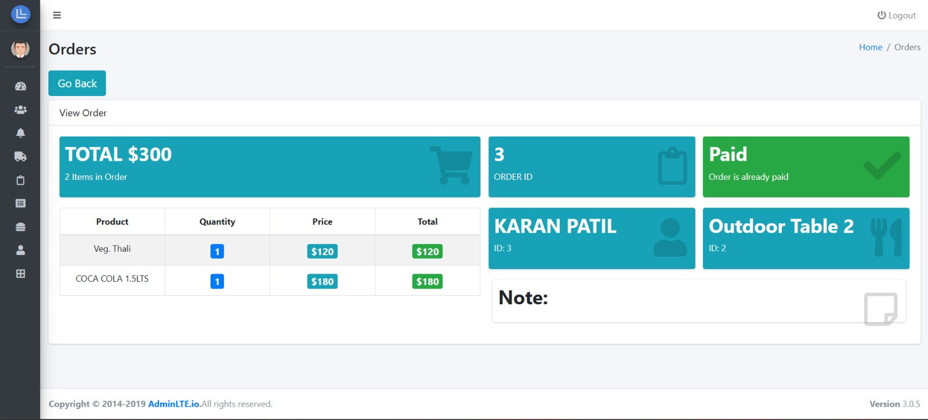
Objectives
Reduced Wait Time for Customers:
By automating the order-taking process, the system allows staff to instantly enter orders into the database. This speeds up the entire process, allowing kitchen staff to start preparing food immediately, reducing the time customers have to wait for their meals.

Slide 6
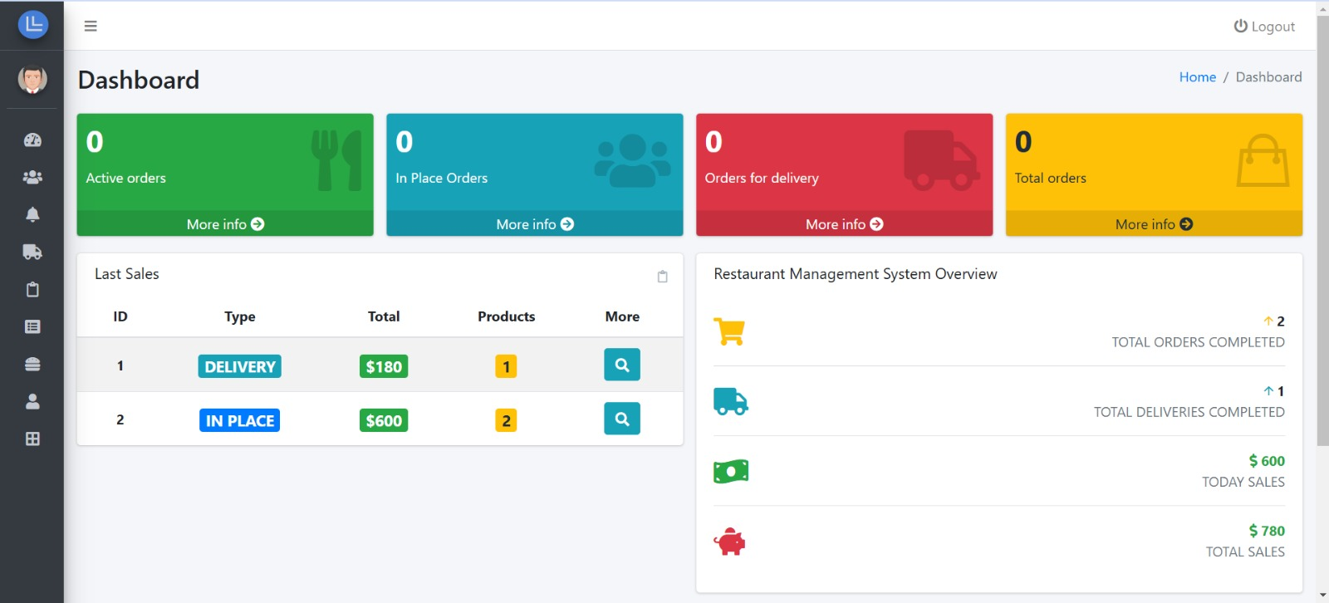
Objectives
Efficient Table Management:
The system provides real-time tracking of table statuses (e.g., occupied, free, reserved). This helps restaurant staff efficiently allocate tables, reducing the chances of overbooking or confusion, ensuring that customers are seated and served promptly

Slide 7
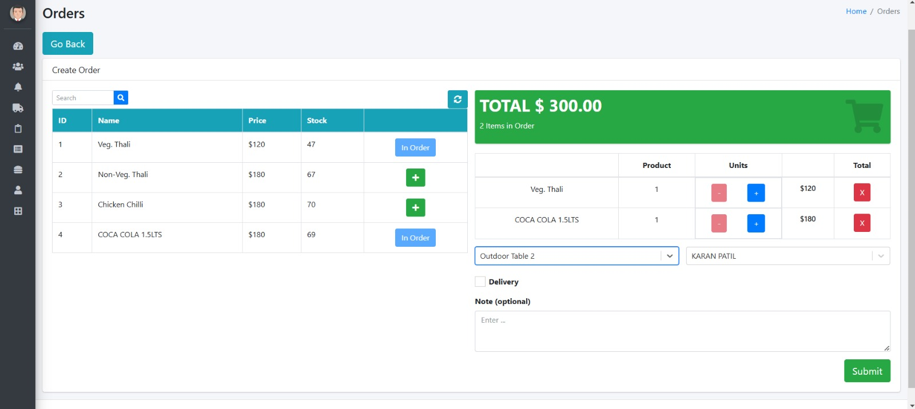
Objectives
Automated Order Updates and Notifications:
The system can provide immediate feedback to both the customers and staff about the status of their orders. For example, once an order is placed, the kitchen receives it instantly, and customers can be notified when their order is being prepared, ready, or delivered. This transparency enhances the customer experience by keeping them informed and reducing anxiety over wait times.

Slide 8
Working
Customers place orders via a user interface or staff input.
User Interface (UI) for Customers:
Customers can place their orders through a digital interface, which could be either a tablet at the table, a self-service kiosk, or an online ordering system. The UI displays the restaurant's menu, allowing customers to browse through various categories (e.g., appetizers, mains, desserts, drinks) and select items. Once customers select their items, the system asks for any customizations or special requests (e.g., "no onions", "extra spicy", etc.).After confirming the order, customers can submit it to the system for processing.
Staff Input:
Alternatively, the waitstaff can input the customer's order manually using a Point of Sale (POS) terminal, especially in cases where the customer prefers to give their order verbally.

Slide 9
Working
Orders are processed and displayed in the kitchen interface.
Order Sent to the Kitchen :
Once an order is placed, the system sends the order details (including items, quantities, and any special requests) to the kitchen in real-time. The kitchen staff sees the order on a digital screen, which displays all the items needed to prepare, their cooking instructions, and the time for each item. The kitchen interface updates the status of the order in real-time (e.g., "Order in progress", "Order ready for serving") so that both kitchen staff and the waitstaff know the current status.
Order Priority:
The system may also prioritize orders based on time and complexity, ensuring that more urgent orders are prepared first or that orders with longer preparation times are started earlier.

Slide 10
Working
Inventory updates automatically with each order.
Inventory Management Integration :
As orders are processed, the system automatically updates the inventory in the backend. For example, if a customer orders a dish that contains tomatoes, the system will reduce the stock of tomatoes in real-time. Each menu item is linked to its ingredients, and the system tracks the amount of each ingredient used as the orders are placed. This helps prevent overstocking or running out of crucial ingredients.

Slide 11
Working
The system generates bills and maintains transaction records.
Bill Creation:
Once the meal is completed and served, the system generates an itemized bill based on the customer's order. The bill includes the prices of individual items, taxes, and any applicable discounts or tips. The system can also allow customers to review their bill before proceeding with payment, ensuring transparency.
Payment Processing:
The system supports multiple payment options, including cash, credit/debit cards, mobile payments, and digital wallets. Payments can be processed through an integrated payment gateway. Once the payment is completed, the system finalizes the transaction and marks the order as "paid."

Slide 12
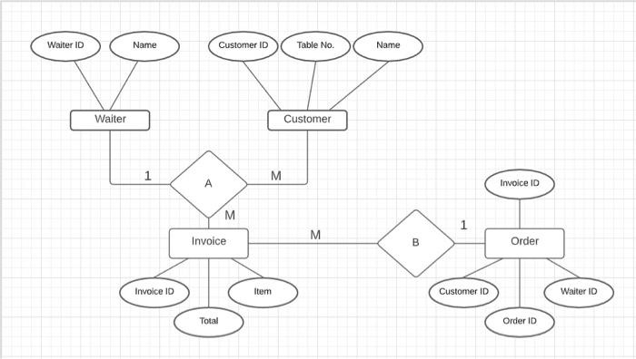
Architecture
Frontend: Developed using HTML, CSS, JavaScript.
Backend: Specify framework Django, Flask, Node.js
Database: Specific database MySQL, MongoDB
Architecture: Client-server model with integrated database access.

Slide 13
Results And Output
Reduced operational errors.
Faster order processing and billing.
Real-time inventory and sales tracking.

Slide 14
Conclusion
The Restaurant Management System makes running a restaurant easier by automating key tasks like taking orders, managing inventory, and processing payments. It helps the restaurant run more smoothly and efficiently, making sure that orders are accurate, stock levels are up to date, and customers get their bills quickly.

